Slide 1
Bellabeat Case Study
Data-driven insights & marketing recommendations

Slide 2
Business Task
• Analyze smart-device usage to uncover behavior trends and prioritise marketing actions.
• Identify which signals best indicate meaningful activity (steps, calories, very active minutes).
• Provide actionable marketing recommendations for Bellabeat products.

Slide 3
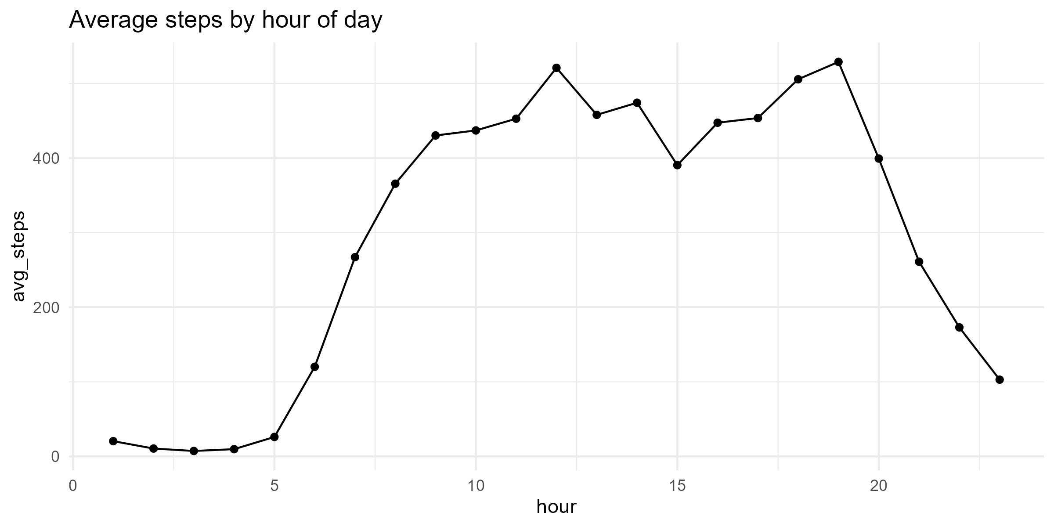
Data Sources & Cleaning
• Data: Kaggle FitBit dataset — daily, hourly and minute-level sheets (30 users).
• Key sheets: dailyActivity, Hourly_Activity_Data, minuteSleep, minute-level steps/calories.
• Cleaning: standardized timestamps, merged minute-level data, filtered probable non-wear days (total_steps >= 1000).

Slide 4
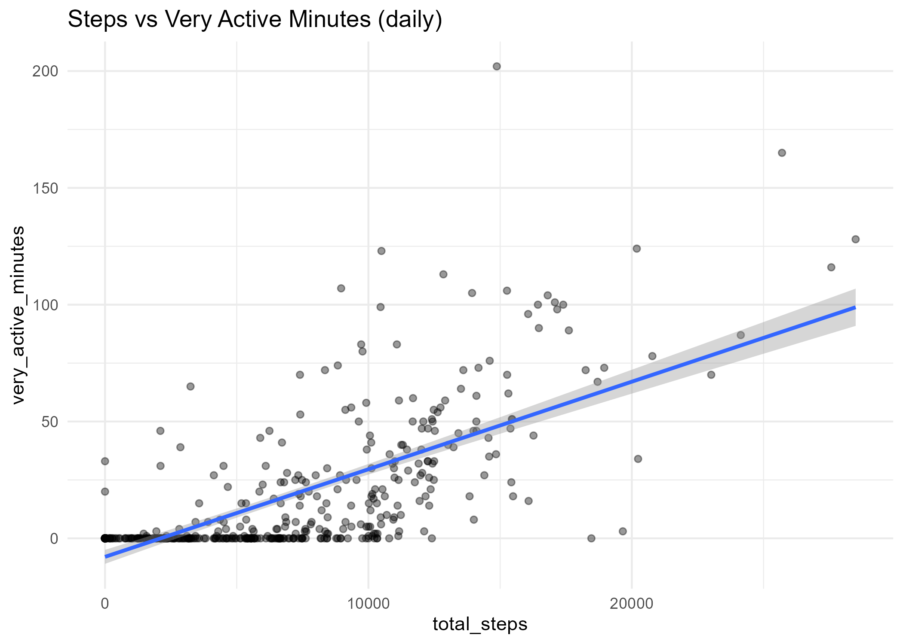
Analysis Summary
• Strong correlation: Steps vs VeryActiveMinutes (r ≈ 0.69) — active minutes are best proxy for exertion.
• Moderate correlation: Steps vs Calories (r ≈ 0.50).
• User segments: Low / Medium / High — targeted actions available.

Slide 5
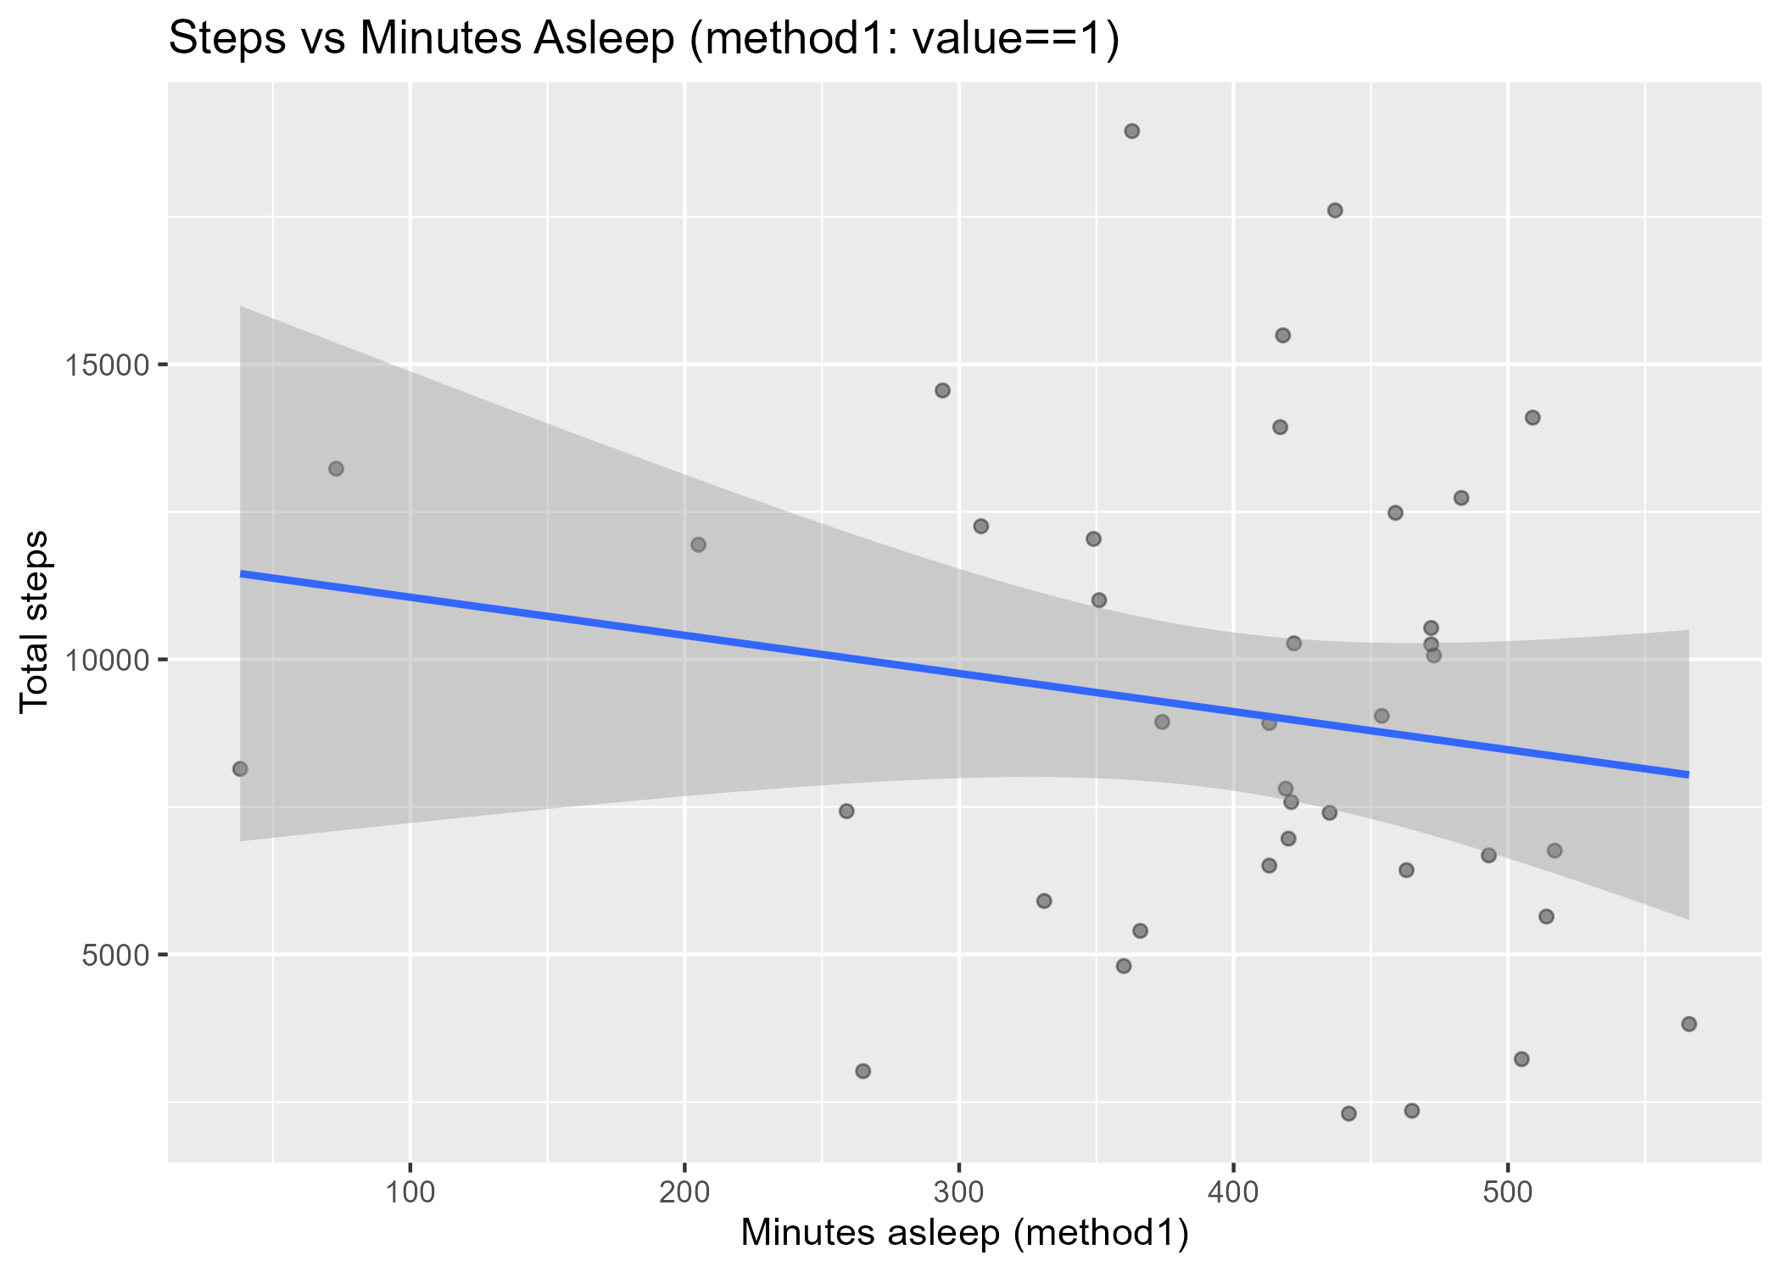
Visuals & Key Findings
• Hourly peaks around noon and 18:00–19:00 — ideal push windows.
• Weekday vs Weekend: no meaningful difference in mean daily steps.
• Sleep linkage: limited matched sample (n=39); no significant linear relation.

Slide 6
Marketing Recommendations
• Primary metric: very_active_minutes — message around '30 minutes active’.
• Segmented campaigns: Low (micro-goals), Medium (challenges), High (upsell).
• Time pushes by hour-of-day, not just by weekday/weekend; A/B test messaging.
• Build dashboards: active-minutes, segment retention, campaign lift.

Slide 7
Thank you
Prepaerd by
Meaad Farag Bayuosef

